Slide 1

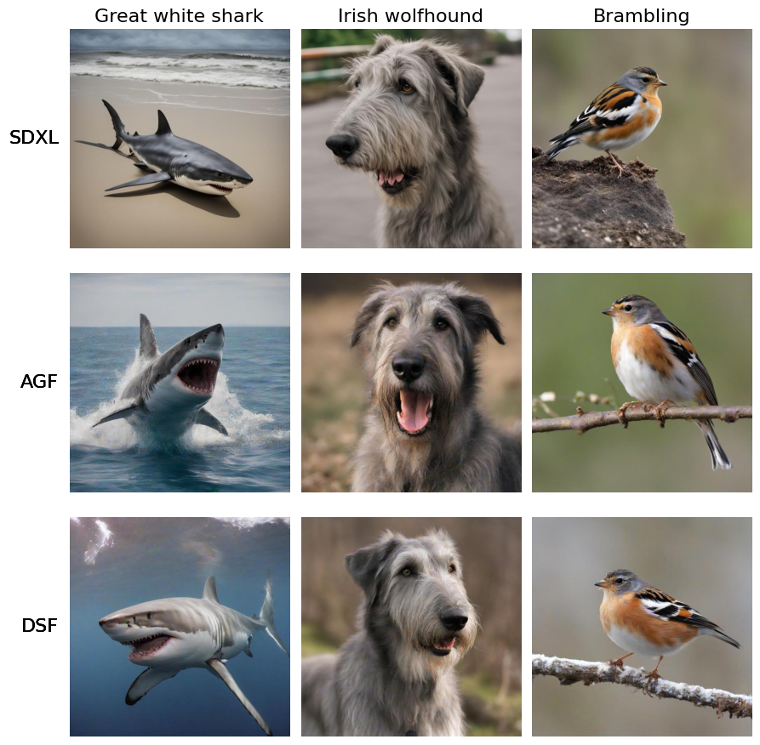
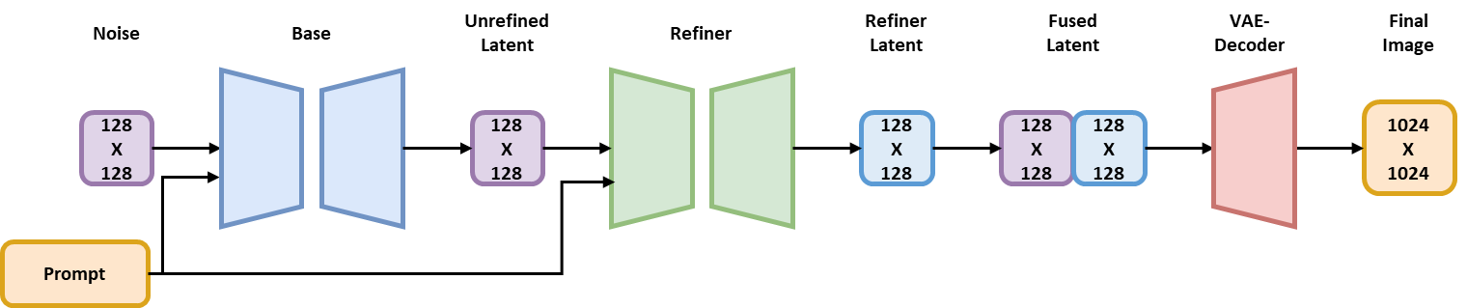
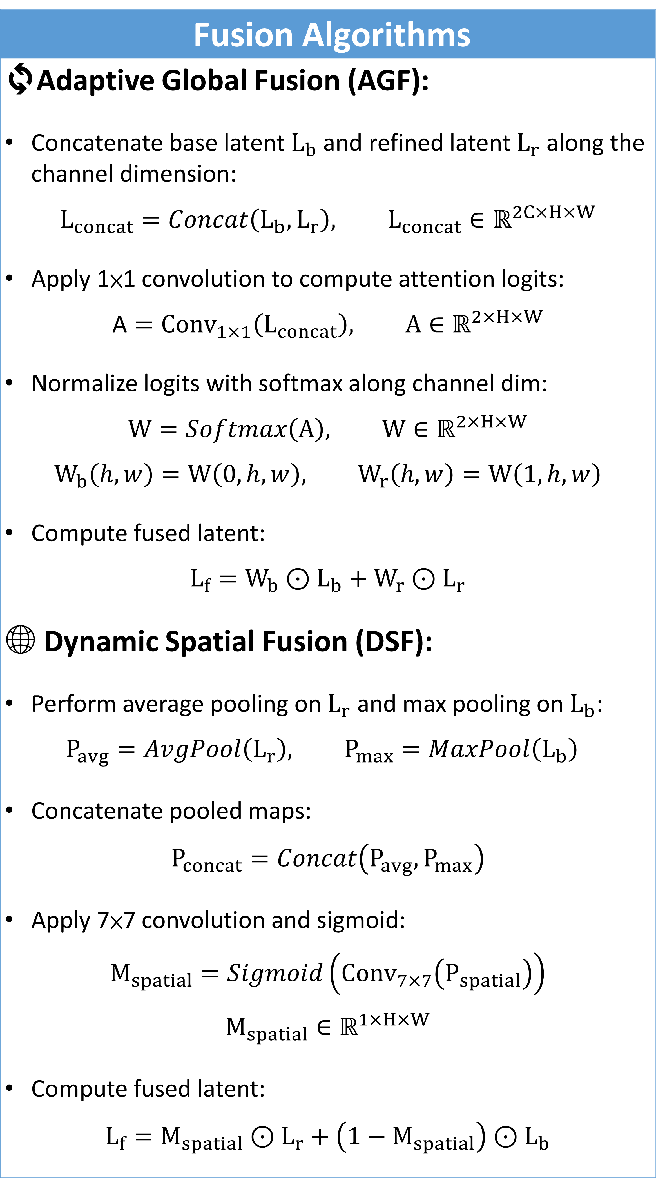
DLSF: Dual-Layer Synergistic Fusion for High-Fidelity Image Synthesis Zhen-Qi Chen, Yuan-Fu Yang National Yang Ming Chiao Tung University
Motivation
Semantic Misalignment ✘ Poor feature fusion leads to inconsistencies between the prompt and generated content (e.g., misplacement of objects, missing parts). Detail Loss ✘ Single-level fusion fails to capture fine-grained textures, especially in complex scenes or high-frequency regions. Insufficient Cross-Latent Communication ✘ Existing models often lack effective interaction between the base and refined latents, limiting the capacity to integrate global and local information.
Fusion Algorithms
🔄Adaptive Global Fusion (AGF): Concatenate base latent $L_{b}$ and refined latent $L_{r}$ along the channel dimension: $$L_{concat}=Concat\left(L_{b},L_{r}\right), L_{concat}∈ℝ^{2C×H×W}$$ Apply 1×1 convolution to compute attention logits: $$\text{A}={Conv}_{1×1}\left(L_{concat}\right), A∈ℝ^{2×H×W}$$ Normalize logits with softmax along channel dim: $$W=Softmax\left(\text{A}\right), W∈ℝ^{2×H×W}$$ $$W_{b}\left(h,w\right)=W\left(0,h,w\right), W_{r}\left(h,w\right)=W\left(1,h,w\right)$$ Compute fused latent: $$L_{f}=W_{b}⊙L_{b}+W_{r}⊙L_{r}$$ 🌐 Dynamic Spatial Fusion (DSF): Perform average pooling on $L_{r}$ and max pooling on $L_{b}$: $$P_{avg}=AvgPool\left(L_{r}\right), P_{max}=MaxPool\left(L_{b}\right)$$ Concatenate pooled maps: $$P_{concat}=Concat\left(P_{avg},P_{max}\right)$$ Apply 7×7 convolution and sigmoid: $$M_{spatial}=Sigmoid\left({Conv}_{7×7}\left(P_{spatial}\right)\right)$$ $$M_{spatial}∈ℝ^{1×H×W}$$ Compute fused latent: $$L_{f}=M_{spatial}⊙L_{r}+\left(1−M_{spatial}\right)⊙L_{b}$$
Experiments
Qualitative comparison among SDXL, AGF, and DSF on three representative ImageNet classes
Method
(a) Overview: We generate a base latent from the prompt and refine it to enhance details. Then, we fuse them via Adaptive Global Fusion (AGF) and Dynamic Spatial Fusion (DSF) to produce high-fidelity images. (b) AGF: Combines base and refined latents using attention weights across feature channels to enhance global consistency. (c) DSF: Applies spatial attention to blend features pixel-wise, preserving fine textures and structure.
Class-Conditional ImageNet 256x256
Method | FID↓ | sFID↓ | IS↑ | Prec↑ | Rec↑
SDXL | 20.16 | 48.98 | 219.74 | 0.86 | 0.35
AGF | 18.79 | 47.64 | 230.43 | 0.87 | 0.39
DSF | 18.89 | 48.21 | 232.04 | 0.87 | 0.39
Class-Conditional ImageNet 512x512
Method | FID↓ | sFID↓ | IS↑ | Prec↑ | Rec↑
SDXL | 19.65 | 50.54 | 234.75 | 0.86 | 0.35
AGF | 18.70 | 49.77 | 243.48 | 0.85 | 0.38
DSF | 18.70 | 50.22 | 243.62 | 0.85 | 0.38

